Slide 1


Computer Vision
Build your own object detector and datasets
Website: plainsight.ai
Youtube: PlainsightAI
Twitter: @PlainsightAI
LinkedIn: plainsightai
Slack: sixgill.tech/slack
Website: SageElliott.com
Twitter: @sagecodes
LinkedIn: Sage Elliott
Medium: @sagecodes
Notes:
--- Connect! ---
https://sixgill.tech/slack
https://www.linkedin.com/in/sageelliott/
https://twitter.com/sagecodes
--- More Content ---
https://www.youtube.com/c/PlainsightAI
https://medium.com/sixgill
--- Setup ----
Modern Web Browser
Google Account
Free Sense Account: https://bit.ly/plainsight-data-annotation

Slide 2
HIT RECORD
A note for me because I forget

Slide 3

Setup
We’ll be using an online Data Science Coding Environment called Colab
To follow along coding you just need
A modern Web Browser (Like chrome)
A Google account (Colab is a tool made by Google)
Sign up for Sense Data Annotation (https://bit.ly/plainsight-data-annotation) - no card required.

Slide 4
What this workshop is
This is a friendly introduction to Computer Vision. No previous experience is expected. But knowing some Python may be helpful.
We will cover: applications and basic intuition, how to label your OWN data, then jump into code and train a model.
You can’t learn EVERYTHING in 2 hours.
You CAN learn enough to get started and excited about Computer Vision.
Parts of it may feel fast paced or challenging, That's OK! You’ll learn a lot by sticking through it.
Keep learning after this workshop! I’ll point you to some resources after.

Slide 5
About Me
I’m Sage Elliott. I’m a Machine Learning Developer Evangelist at plainsight.ai
We do awesome stuff with Machine Learning, Computer Vision & IoT across many industries! And we create tools to make it easier for everyone!
For about the past decade I’ve worked in software or hardware with startups and agencies in Seattle, WA and Melbourne, FL.
I love making things with technology!
Stay Connected:
SageElliott.com | @sagecodes | Linkedin
Notes:
https://sixgill.tech/slack
https://www.linkedin.com/in/sageelliott/
https://github.com/sagecodes
https://twitter.com/sagecodes
https://medium.com/@sagecodes

Slide 6
About you!
Normally I’d have you introduce yourselves here, but since the RSVP count was so high, I thought it would be better to wait until after the class.
But Communicate in the chat: Where are you watching this from? I’m in Seattle.
Why are you interested in Why are you interested in Computer Vision?
Stay connected on slack: https://sixgill.tech/slack
Introduce yourself in the introduction channel!
Notes:
https://www.linkedin.com/groups/13929123/
https://sixgill.tech/slack
Introduce yourself in the introduction channel!

Slide 7
Setup (repeat for anyone who just arrived)
We’ll be using an online Data Science Coding Environment called Colab
To follow along coding you just need
A modern Web Browser (Like chrome)
A Google account (Colab is a tool made by Google)
Sign up for Sense Data Annotation (https://bit.ly/plainsight-data-annotation) - no card required.

Slide 8
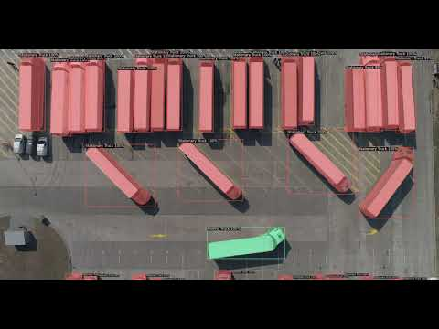
What is Computer Vision?
It’s a pretty big field, but I would boil it down to:
How computers gain understanding from images or videos.
There are other data types as well.
Audio can turn into images

Slide 9
Why I Love Computer Vision?
I think it’s an amazing interface into the world!
We’re already doing amazing things with it today!

Slide 10
Who uses Computer Vision?
More and more companies are using computer vision across multiple fields.
Amazon:
Amazon GO
Delivery Robots
Self Driving Cars
Product listings
Google:
Google Photos
Youtube filtering
Self Driving Cars
Tesla:
Self Driving Cars
Facebook:
Face tagging
Agriculture:
Crop monitoring
Animal monitoring
Construction:
Site monitoring
Self Driving Tractors
Manufacturing:
Quality Assurance
Throughput
Supply Chain
Oil & Gas
Leak Detection
Safety
Healthcare:
X-ray Diagnostics
MRI scans
Medicine Research

Slide 11
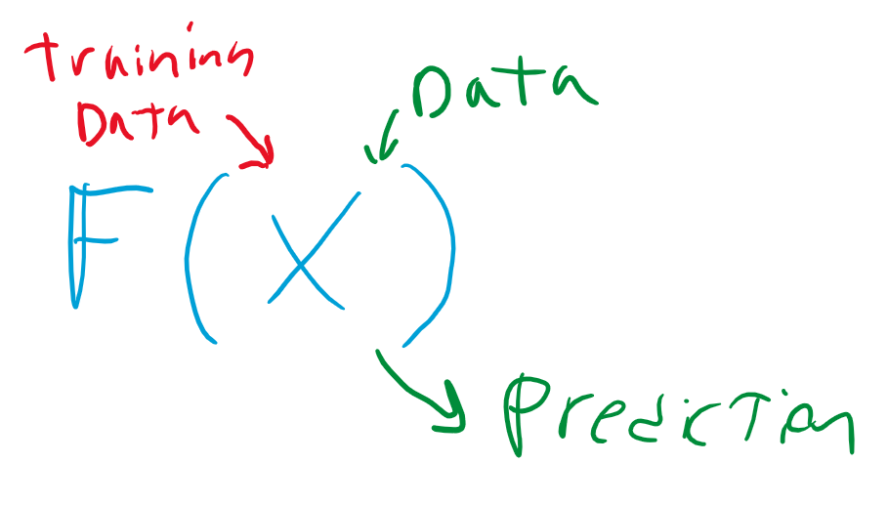
Computer Vision & Deep Learning
Computer Vision isn’t always tied to Deep Learning.
But in the past decade or so deep learning in the field of computer vision has been dominating complex problems.
Other intros will cover deep learning more in depth
Deep Neural network:
https://playground.tensorflow.org/
Convolutional Neural Network https://www.cs.ryerson.ca/~aharley/vis/conv/flat.html

Slide 12
Transfer Learning
With most popular deep learning frameworks you can load pre-trained weights into your network. These have been trained extensively on quite a few objects and animals.
You can then adjust those weights during training to work for you specific data set.
Think of it as not starting from zero.
Imagenet data set
Coco dataset
A good rule of thumb for a hobby project is to start with a minimum 200 images transfer learning. But this can vary a lot depending on your data and the results you want.
without transfer learning you will probably need thousands of images and a lot more time.

Slide 13
Some Types of Computer Vision
Computer Vision is a big field
We’re going to focus on computer vision with Deep Learning
Many of these types can be combined together or with other algorithms to form various outcomes. I’ll talk about this as we go!

Slide 14
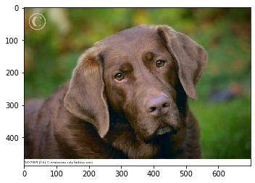
Classification
Prediction: Labrador Retriever
Classification is often trained on a whole image or portion of an image.
Most tutorials will start here and cover classification thoroughly.

Slide 15
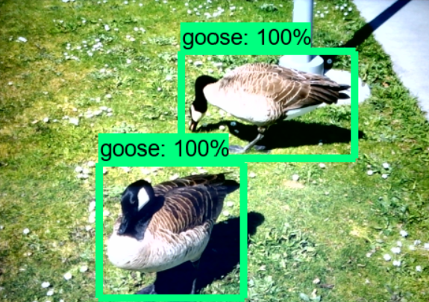
Object Detection
Object Detection can classify and localize where an object is inside of an image or video.
We’re going to make this today!
And cover how to make your own dataset for this.

Slide 16
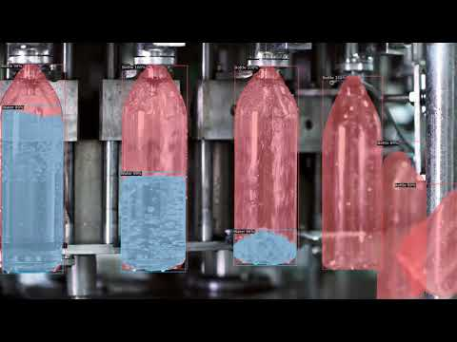
Instance Segmentation
Like object detection Image segmentation can classify and localize where an object is in an image, but understand more precisely what is actually part of the detection.

Slide 17
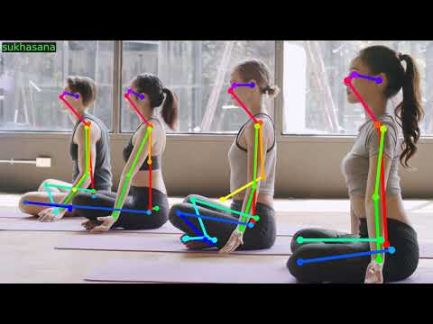
Feature Point Clustering
Understand and track key features of an object.
Common for pose estimation and facial feature or moods.

Slide 18
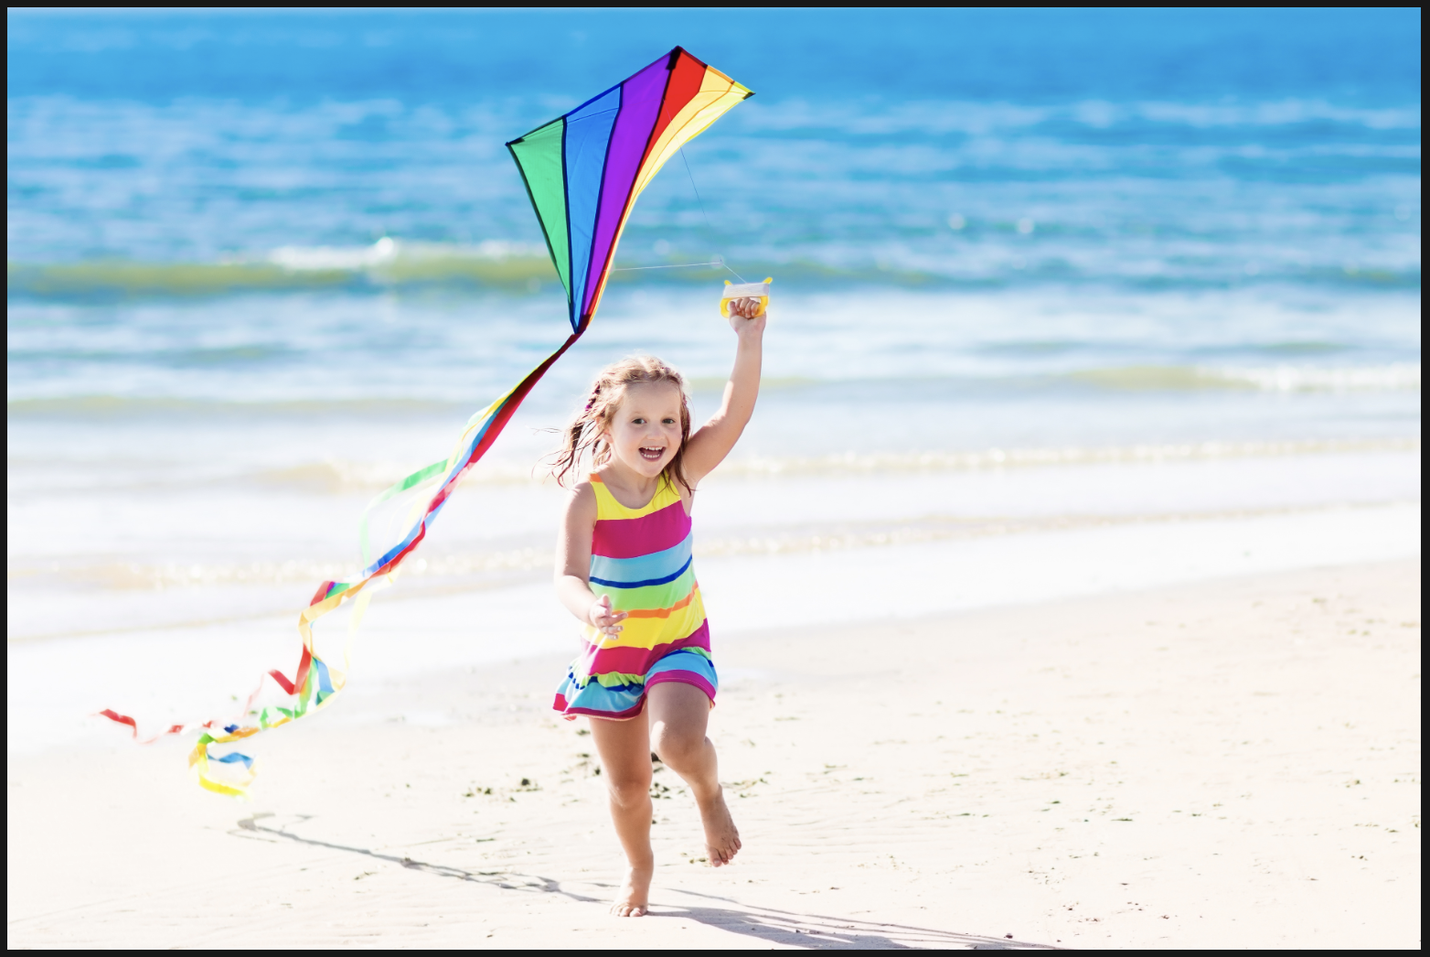
Image Captioning (Text)
Understanding the context of an image.
Predicted: "Child flying kite on tropical beach"

Slide 19
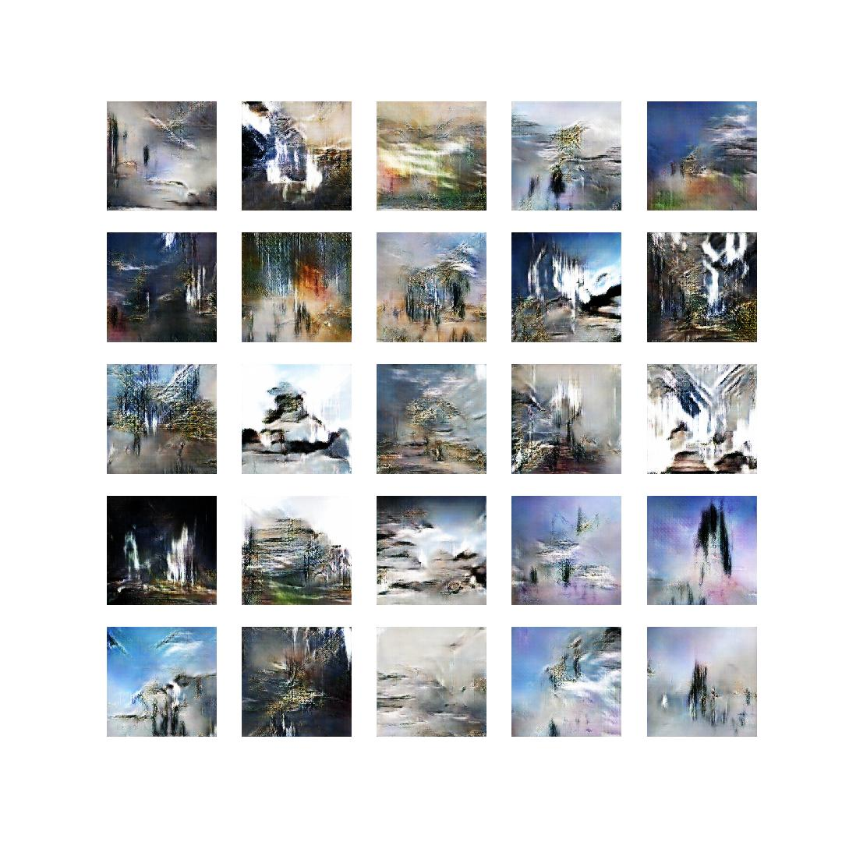
Generative Deep Learning
Generative Adversarial Networks
Those Generated faces used a GAN.
Here is a more simple example:
http://www.michaelhasey.com/gan-exterior
https://medium.com/syncedreview/gan-2-0-nvidias-hyperrealistic-face-generator-e3439d33ebaf

Slide 20
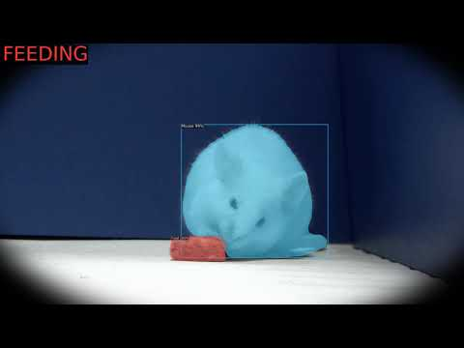
Choosing a model
There can be many use cases for different models and ways to tie them together.
When getting started think about what the problem is you’re solving and what outcome are you looking for?

Slide 21
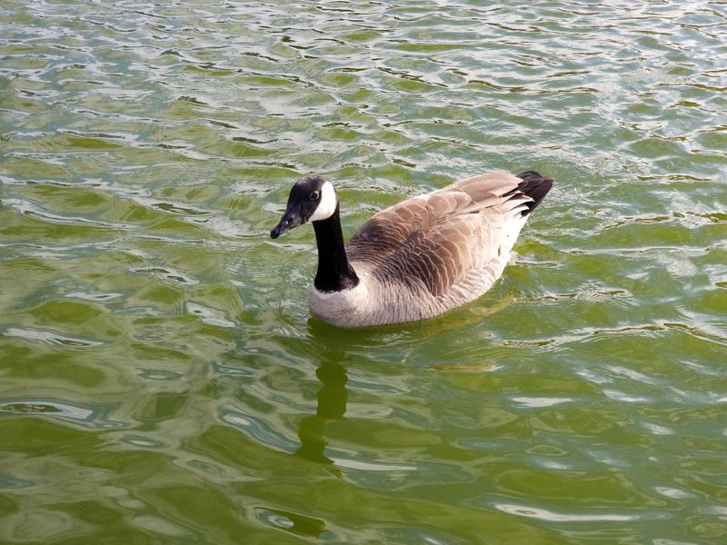
Object Detection gist
Find proposed regions
Run classifier around region
Calculate estimation of object location
More links will be shared on different object detectors
https://medium.com/@jonathan_hui/image-segmentation-with-mask-r-cnn-ebe6d793272

Slide 22
Popular Object Detection Methods
Single Shot MultiBox Detector (SSD): Object detection & Fast
You Only Look Once (YOLO): Object detection & Fast
Mask R-CNN: Object detection, Image segmentation. High accuracy, Slower
Facebook Detectron2 < - - What we’re going to use
https://ai.facebook.com/blog/-detectron2-a-pytorch-based-modular-object-detection-library-/

Slide 23
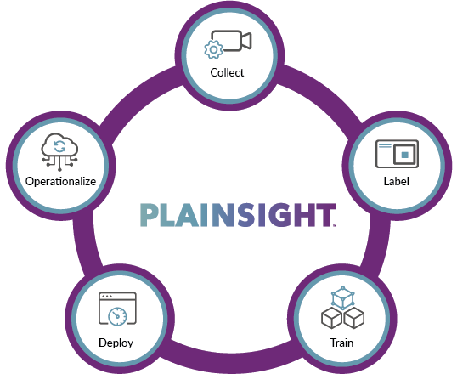
The Full Computer Vision Life Cycle
Device Management - Edge Computing & Sensors
Data Collection - Managing Data from Sensors. Creating Datasets, Web Scraping
Data Annotation (Labeling)
Machine Learning - Model selection & Training
Deployment - Running a model on an edge or cloud device
Repeat for continuous machine learning

Slide 24


We do all of that in one platform
We do all of those steps in one platform with our Sense product.
If you want to learn more about it or schedule a demo, let me know!
Or need managed labeling, custom model building, or other ML solutions
https://plainsight.ai/contact/
Now on Google Cloud Marketplace
https://plainsight.ai/gcm

Slide 25
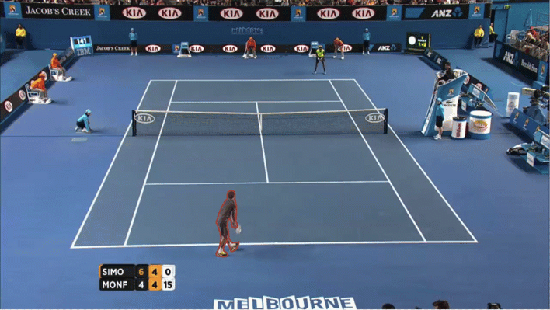
Image Labeling (Data Annotations)
Most of those different model types need different types of data annotation to learn. Labeling is a HUGE part of computer vision that people don’t often think about when starting.
Sign up for Sense Data Annotation (https://bit.ly/plainsight-data-annotation - no card required.
More AI assisted labeling features coming soon!
Notes:
https://drive.google.com/drive/folders/1xflrGoyNFlP9omFIYLKNc7uNZzD2C01s?usp=sharing

Slide 26
Popular Python Libraries used for Computer Vision
There are many…. But here are few to know about as you get started
Pytorch
Library from Facebook for Machine Learning. Popular in Deep Learning.
OpenCV
Awesome library for image processing & computer vision
Pil / Pillow
Image processing library
Tensorflow + Keras
Library from Google for Machine Learning. Popular in Deep Learning.
Numpy
Great at processing multidimensional arrays. (Images).

Slide 27
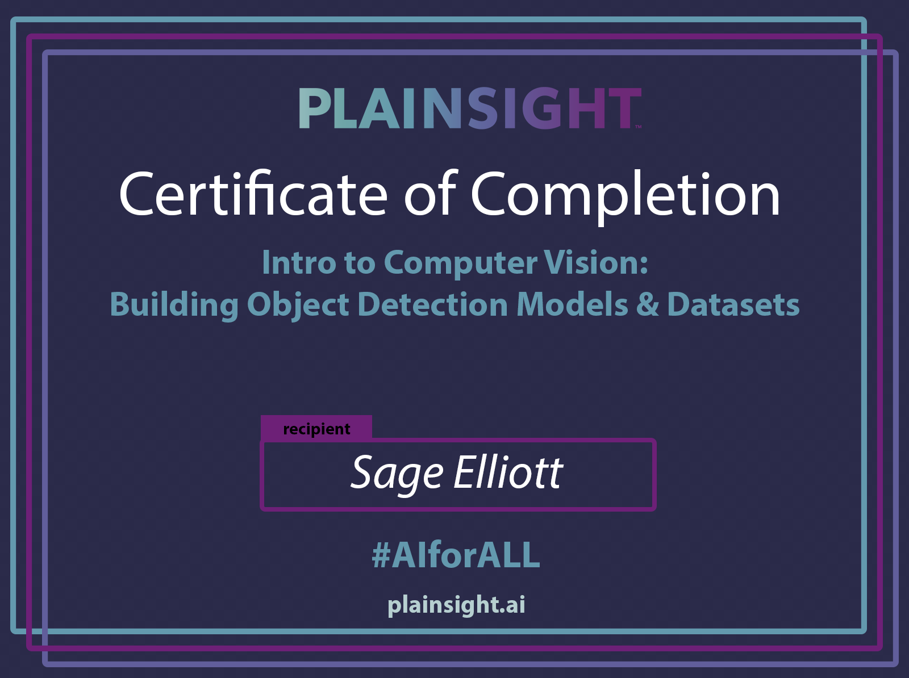
Let’s build an object detector!
It’s OK if something doesn’t make sense. Computer Vision is complicated!
http://sixgill.tech/object-detection-pt1-8
Notes:
https://github.com/sagecodes/geese-object-detection-dataset

